Slide 1
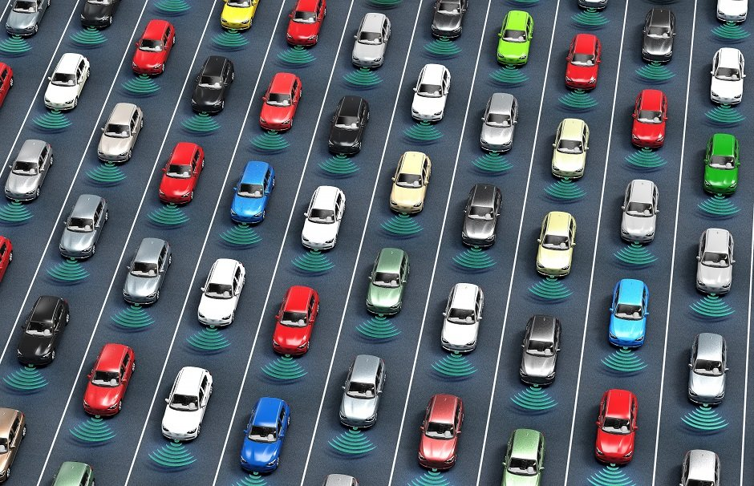
Lane Detection using Particle Filtering
CS682
Abhishek Bodas - G01160204
Aditya Indoori - G01129724
Gaurav Bahl - G01057667
Prashant Sahu - G01149803
Pushkal Reddy - G01166539

Slide 2
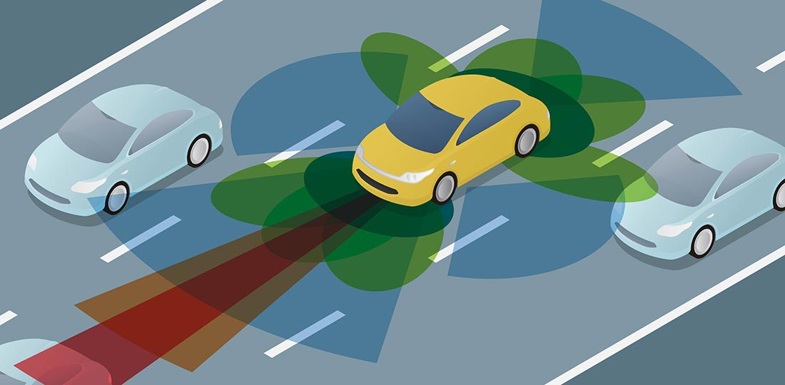
The Problem:
The fundamental goal for any self-driving vehicle is to drive without errors. The simplest way to achieve that is to stay within the lane and change only when necessary.
However, to stay within a lane, a car must first be able to detect the lane it is in. The problem of detecting a lane can be accomplished through a combination of various computer vision techniques.
Notes:
Intro
The fundamental goal for any self-driving vehicle is to drive without errors. The simplest way to achieve that is to stay within the lane and change only when necessary.
The goal is to achieve autonomous driving which can reduce casualties from road accidents.
A secondary goal that can be achieved is that we can reduce pollution levels by having a synchronized system of autonomous cars.
Having autonomous driving will also reduce commute over time by having optimized routes which saves time.
Furthermore, the techniques developed for lane detection can be repurposed in other applications of Computer Vision such as augmented reality.

Slide 3
Our Approach:
The course CS 682: Computer Vision has taught us techniques such as perspective transformation, edge detection, distance transform, and particle filters among many others.
Using a combination of these powerful techniques and tools like OpenCV for Python, we hope to devise an efficient algorithm that allows a camera system mounted on any car to detect the lane it is in.
Effectively accomplishing this task can drastically improve the driving capability of a car.
Notes:
Our approach involves using Computer Vision techniques that we’ve learned over the semester.
We used a combination of techniques like perspective transformation, edge detection, distance transform to process the incoming images.
Finally we applied particle filtering for lane detection over the processed images.

Slide 4
Particle Filter:
Algorithm to track set of features by building a model which describes motion of particles.
Involves predicting and updating the particle weights based on their probabilities and resampling the data.
Algorithm involves particle initialization, generation, weight calculation and resampling.
Notes:
The general idea of a particle filter is to track a set of features based on a model that describes the motion of those particles.
Project a set of particles on the image being processed
Then we Assign each particle weight based on their probabilities
Finally we resample the particles based on their weights to give our estimate of the lane’s position. Then performing a similar process for future frames
It is also useful to handle scenarios where the lane markings are missing or unclear.
Particle Filtering is useful in estimating where the lane might be in those cases

Slide 5
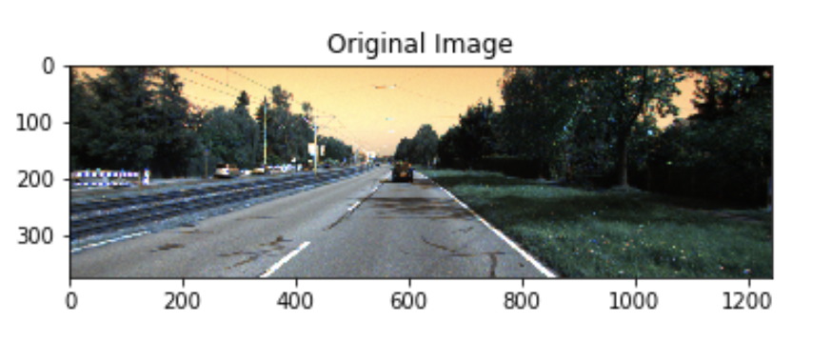
Original Image:
KITTI dataset
RGB images
Resolution: 375 X 1242
Includes markings on both sides of the lane dotted on one side and solid on another.
Notes:
In a real-life scenario, we will be getting the input from a video camera positioned on the vehicle.
The video provided by the camera will be the input stream of RGB images for the Particle Filtering algorithm.
In our project, we use a similar data set that was acquired from KITTI. KITTI is a project developed by Karlsruhe Institute of Technology and Toyota Technical College in Chicago.
They have collected images by using a fleet of cars which they are using for autonomous driving. The data collected by them has been made available to the public for academic and research purposes.
We have chosen a data set of Urban Marked Roads from their database. The data set provides RGB images with a resolution of 375 X 1242 of urban roads with marking on both sides (dotted and solid).

Slide 6
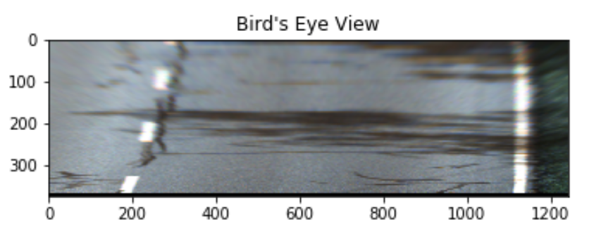
Inverse Perspective Transform:
Pre-processing step for edge detection and distance transform.
Changes the perspective from the camera view to the bird's eye view.
Four corner coordinates around the lanes are selected. (creating a trapezoid)
Selected coordinates are converted to a rectangular perspective with lanes parallel to each other.
Notes:
4 point technique applied on each frame to convert to bird views

Slide 7
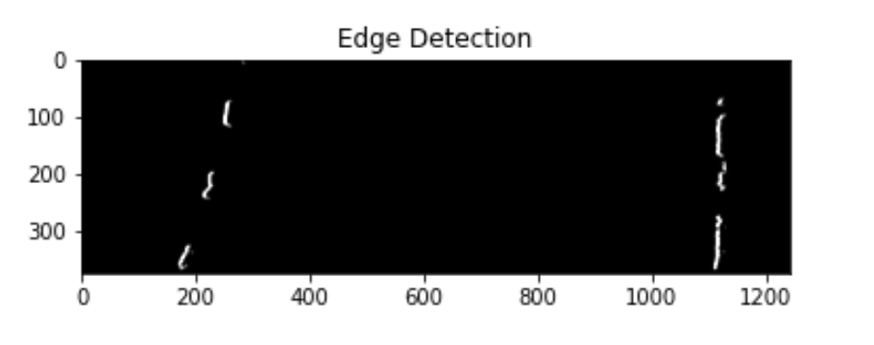
Edge Detection
Applying Threshold.
Applying Smoothing.
Using Sobel derivatives to find vertical edges of the lane pixels.
Notes:
Sobel - 1,0
Sobel on y as we want vertical edges

Slide 8
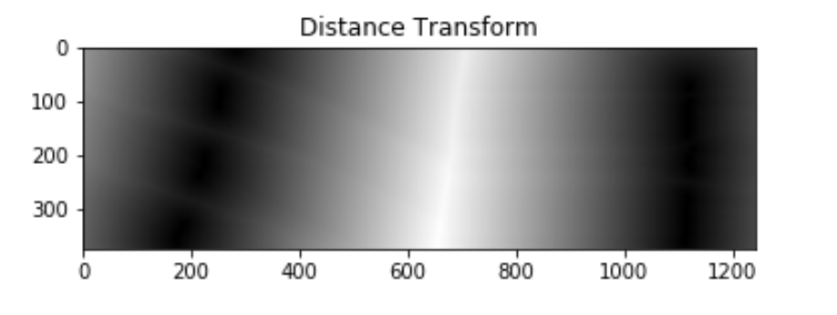
Distance Transform
Pre-processing step for particle filtering.
Applied on the detected edges.
Displays the high-intensity lane pixels.

Slide 9
PF: Initialization
Vector Representation: [l, r, b, g]
l: Column (x-coordinate) of the lane’s left edge.
r: Column (x-coordinate) of the lane’s right edge
b: The slope of the lane’s left edge.
g: The slope of the lane’s right edge.
Detecting (l,y) and (r,y) coordinates.
Setting b,g =0
Initial particle: [l, r, b, g]
Notes:
Initialization :
Each particle is described by l, r,b,g.
L is position of left lane, R is position of right lane
B is curvature angle for left lane, G is curvature angle for right lane
Use Dist Trans to find L and R. We set the initial b and g as 0.

Slide 10
PF: Particle Generation
Generating ‘n’ random particles using a uniform distribution.
Particles generated in the neighborhood of the previously predicted particle.
For better results, a larger number of generated particles are used. (n=500)
Notes:
20 pixels (plus minus) around L and R to generate new particles around previous particle
0.5 radians for B and G to generate new particles around previous particle

Slide 11
PF: Weight Calculation
Calculating the mean squared error between actual and predicted ‘n’ particles.
Assigning the weights to the predicted particles based on the inversely proportional mean squared error values.
Normalizing the weight.
Notes:
Using mean squared error to find the distance between previous particle and predicted particle.

Slide 12
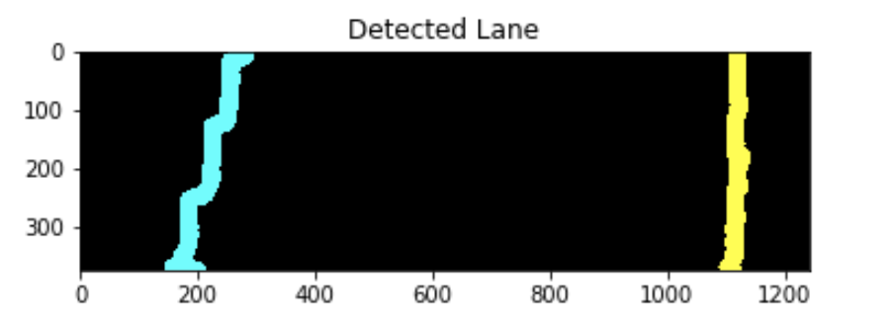
PF: Resampling & Repeat
Resampling: Selection process to choose winning particles based on the maximum weights.
Winning particles help in predicting the random particles on the next row (y+delta).
Repeating every 5th row, starting from the last row on the y-axis. (delta=5)
For faster processing, we could consider delta=10.
Notes:
We pick top two winning particles from the 500 particles we projected.
Then we take mean of the two winning particles.
Then we add the mean L and R values of the winning particles to array for Left and Right Lane arrays respectively..
After that we plot those two arrays with cv2.polylines() and plot them with cyan and yellow colors. We can see the detected lane in the image presented

Slide 13
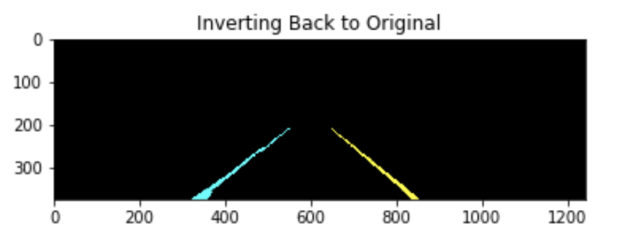
Perspective Transform
Changes the perspective from the bird's eye view to the camera view.
Previously selected four corner coordinates are back-projected onto the original image.
Selected coordinates are converted to a trapezoidal perspective with the lanes intersecting at a vanishing point.

Slide 14
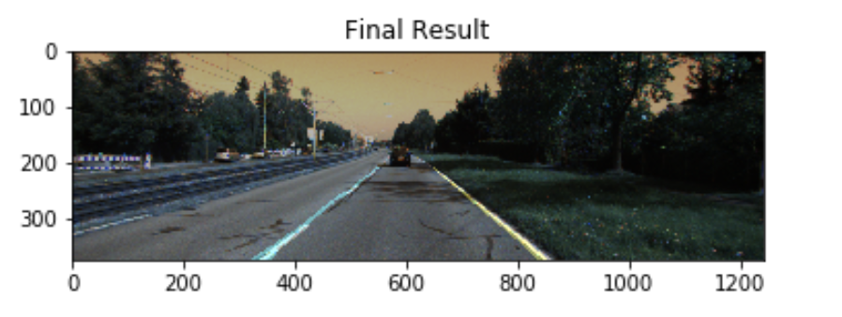
Merge & Display
The lane-detected image is merged with the original image to obtain the final result.
Lanes are displayed using polylines - Cyan for dotted left lane and yellow for the solid right lane.
Images converted into a video of 5 fps to display continuous detection for demo purposes.
Notes:
Extra point: In real life we would need to match the processing speed to the fps rate of the camera in order to give correct real time lane detection.

Slide 15
Challenges Faced
If in the initial image, particle values were missing, in such case, the constant values such as 200 for left lane and 1100 for the right lane were selected.
In the case of missing particle values due to dotted left lane, previous left and right lane values were considered.
Surrounding trees and poles project shadows on the lanes, which resulted in incorrect lane detection. This case was handled by modifying the Particle Filtering algorithm.
Notes:
In the off chance that our initial L and R values are not detected(if the first row hits the gap in dotted lane) then we chose a constant value so that the particles don’t get project too far out. We chose L =200 and R =1100 for those cases.
We are ignoring outlier values for L and R to avoid the incorrect detections caused by Trees and Poles. If the L and R values are beyond a certain threshold we chose to ignore them. This helped handle shadows or other visual disturbances on the road.

Slide 16
Future Work
Increasing time efficacy:
Running the system using an optimized CPU.
Improving the performance of the algorithm by optimizing the weight function and tuning the parameters.
Camera Calibration:
Using the calibration details for better perspective transform which will result in noise-free detection.

Slide 17
Conclusion
Smart vehicles must be able to detect the lane it is driving on to save human lives from unnecessary road accidents.
By employing powerful tools like OpenCV and concepts like particle filtering, any vehicle can detect lanes with high accuracy.

Slide 18
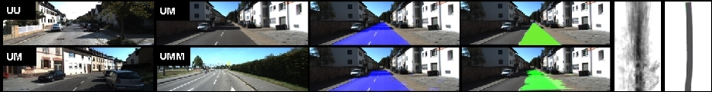
Dataset:
The Road/Lane Detection Dataset from KITTI Project:
http://www.cvlibs.net/datasets/kitti/raw_data.php?type=road
References:
G. Liu, F. Wörgötter and I. Markelić, "Combining Statistical Hough Transform and Particle Filter for robust lane detection and tracking," 2010 IEEE Intelligent Vehicles Symposium, San Diego, CA, 2010, pp. 993-997.
VanQuang Nguyen, Heungsuk Kim, SeoChang Jun, Kwangsuck Boo, "A Study on Real-Time Detection Method of Lane and Vehicle for Lane Change Assistant System Using Vision System on Highway", Engineering Science and Technology, an International Journal, Volume 21, Issue 5, 2018, Pages 822-833, ISSN 2215-0986

Slide 19
DEMO!
Link: https://streamable.com/yf3nyr

Slide 20
Questions

